Slide 1


CVSSP Job Control System aka HTCondor
Oscar Mendez
Credits: Kosta Polyzos & Necati Cihan Camgoz
cvssp wiki page

Slide 2
Overview
What is Condor?
Interaction with Condor: basic commands
What Condor ISN’T
How do you get Help?
Condor Tutorial
  Example #1: Hello World!
  Example #2: Interactive jobs
  ...
  Example #7: Condor with Docker

Slide 3



Honourable Mention
Cihan Used to present this slides (and spear-headed condor)

Slide 4


Honourable Mention
Cihan Used to present this slides (and spear-headed condor)
We’ve since upgraded!

Slide 5
Running heavy jobs - the conventional way
Login to a server:
$ ssh server.eps.surrey.ac.uk
Execute the job:
$ nohup myexe -a1 one -a2 two >& log_file &
Arguments
Your program
Detach from terminal
No HangUP: safe to logoff
Redirect stdout/stderr to a log file
Notes:
Look simple enough. Why Condor then?

Slide 6



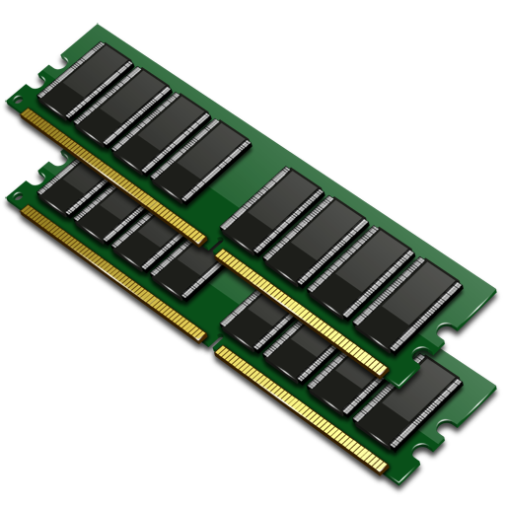

Problems
Dude, there’s a secret server recently added in CVSSP.
I’ll treat ya ice-cream. Tell me about it.
What servers? When available?
  CVSSP has >40 servers with different resources (RAM, GPU, CPU, StorNext, ...)
  http://personal.ee.surrey.ac.uk/Personal/J.Collomosse/load.html
Hard to update/maintain
Hard to have fair usage among users
(power users dominate).

Slide 7


What is HTCondor?
Queue
job #1
User #1
job #2
User #2
Condor Central Manager
Submit & Schedule
cvssp-condor-master
job #3
User #3
Execute Nodes/Hosts
Notes:
Open-source Software
Developed at Uni of Wistconsin US
Maintain a pool of servers, or execute nodes.
Submit tasks to a queue (on a submit point)
HTCondor schedules them to run on computers (execute points)
High Throughput Computing.

Slide 8
How does Condor work
How Condor matches jobs to hosts/servers?
ClassAds
User priority
Job requirements
Job 1: 2 CPUs, 1GB RAM, 1 GPU
Job 2: 3GB RAM, docker
Job 3: 2 CPUs, stornext
Available resources
Host 1: 32 CPUs, 160GB RAM, docker
Host 2: 16 CPUs, 64 GB RAM, 7 GPUs
Host 3: 16 CPUs, StorNext, Matlab
User | Jobs | Prio
 | 6 CPUs, 30 GB RAM, 1 GPU | 5000
 | 10 CPUs, Matlab | 1000
 | 10 GB RAM | 200
Host priority
Behavior control
Host | Resource currently available | Prefer job from
#1* | 16 CPUs, 100 GB RAM, 2 GPU
#2 | 17 CPUs, 160 GB RAM, Matlab | -
#3 | 32 CPUs, 52 GB RAN, StorNext | -
Host | resources | Custom requirements
#1 | 7 GPUs | Use 1 GPU or nothing
#2 | 32 CPUs, 128GB RAM | All I can spare: 10 CPUs, 30GB RAM
#3 | 160 GB RAM, Matlab | I won’t run jobs for > 2h unless from
Notes:
Check out Machine Ranking of Jobs
Machines advertise their resources as usual.
Users submit their jobs as usual.
User have an effective priority associated with them.
Calculated constantly.
Factor of: Priority multiplier, real priority aka current usage, Time aka dissolves over time.
Condor starts sharing resource slices to the user with the best priority.
Condor will by default prefer a node that has a free slot.
If there are no free slots, we might choose to : Wait for the job to finish, or evict jobs in favor of higher rank/user prio
Lets assume that all resources are taken
HTCondor will consider Host 1 as a machine that can run the jobs During sorting it will come up on top
Decide if it can evict currently running processes for the said ones.

Slide 9
How to run a job with Condor
Login to condor.eps.surrey.ac.uk :
$ ssh condor
Create a submit_file
Submit the job with Condor:
$ condor_submit submit_file
NOTE: Submit files modified from your PC might take time to update on server!
universe = vanilla
executable = myexe
arguments = -a1 one -a2 two
log = mycondor.log
output = myoutput.log
error = myerror.log
request_GPUs = 1
request_CPUs = 4
request_memory = 2000
# QUEUE is the "start button"
queue 1

Slide 10
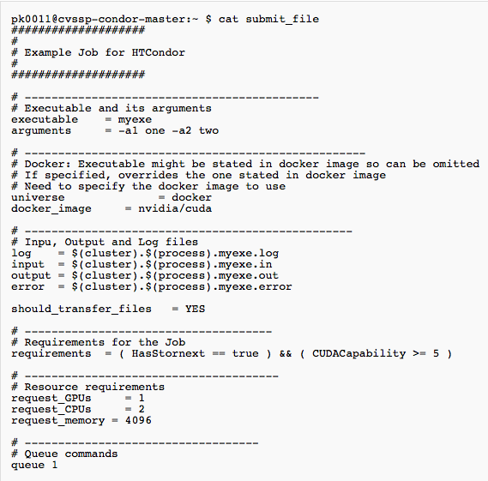
Submit file → Jobs
Different than just a path to an executable and params:
Required Resources
(i.e. #GPU, #CPU, #Memory)
Requirements
(i.e. Docker, StorNext, SW)
Preferences
(i.e. target machine)
Environment
(i.e. Vanilla, Docker)
Mounting Points
(i.e. /vol/vssp)
(NOTE: Don’t mount homespaces, it’s slow and might cause trouble with anaconda, etc.)
Submit Multiple Jobs
Never use CUDA_VISIBLE_DEVICES
Notes:
Submit files communicate everything HTcondor needs to know about a job.
Preferences - ranking of machines you want your job to run on.
Universe - vanilla/docker
Files?
Number of jobs to queue
Can you do that in a single submit file? I.e. number of jobs?

Slide 11
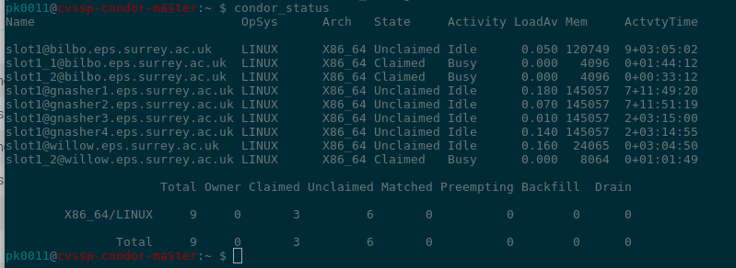
Interaction with HTCondor - Pool status
Q
condor_status
Condor Central Manager
Submit & Schedule
cvssp-condor-master

Slide 12
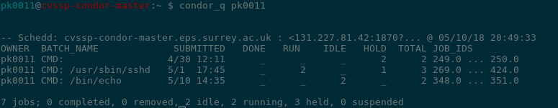
Interaction with HTCondor - Queue status
Q
Condor Central Manager
Submit & Schedule
cvssp-condor-master
condor_q

Slide 13
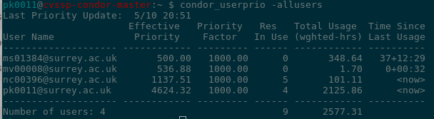
Interaction with HTCondor - Priorities status
Q
Condor Central Manager
Submit & Schedule
cvssp-condor-master
condor_userprio

Slide 14
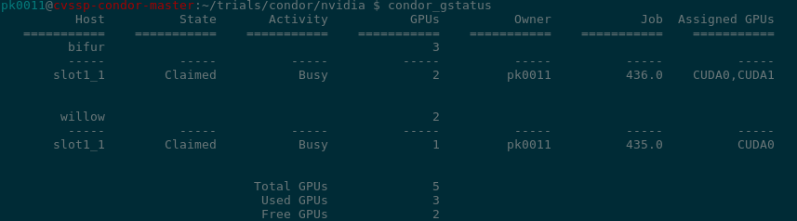
Interaction with HTCondor - GPUs
Q
Condor Central Manager
Submit & Schedule
cvssp-condor-master
condor_gstatus

Slide 15


HTCondor & Docker
Just like any other job!
Can run job as a Docker container
Can use any image accessible on DockerHub or any private/public registry
If GPUs requested NVIDIA runtime is used
Good if you want a special running environment
Access to Home Dir
Access to project spaces
Access to network ports
CUDA_VISIBLE_DEVICES:
  IF you are using a library that uses this,
  you should be using Docker!
universe = docker
docker_image = registry.eps.surrey.ac.uk/archangel:4df819e
executable = myexe
arguments = -a1 one -a2 two

Slide 16
What Condor ISN’T
Magic
  Condor isn’t Magic: You will hear me say this.
  You will need to put in WORK to make condor work.
A replacement for niceness and good will:
  Respect Deadlines
    Don’t launch 1000’s of jobs right before a deadline
  Respect Resources
    Don’t launch CPU jobs on GPU machines
    Don’t take a 40GB GPU for something that needs 5GB
  Respect Others:
    POLITELY let people know if you think they are misusing condor
    If you are told you are misusing condor, listen
Bulletproof
  There ARE bugs, annoyances, quirks, hacks, abuses, etc.

Slide 17
What Condor ISN’T
A buffet:
  We try to cater for everyone, but generic solutions are always preferable.
Your personal supercomputer:
  BE NICE!
A programmer:
  Condor won’t fix your code
  You WILL need to make your code condor friendly (it’s normally easy!)
Static
  If you run into problems, let us know.
  If condor isn’t working for you, let us know
  Condor is constantly evolving to meet our needs
MAGIC
  Condor isn’t magic!
  We rely on YOU for that.

Slide 18
How do you get help?
CVSSP wiki
https://cvssp.org/mediawiki/index.php/CVSSP_Job_Control_System
https://bookstack.eps.surrey.ac.uk/books/htcondor---job-scheduling
Gitlab:
https://gitlab.eps.surrey.ac.uk/cvssp-condor/condor-examples
https://gitlab.eps.surrey.ac.uk/cvssp-shared-dockerfiles
TEAMS: https://teams.microsoft.com/l/team/19%3a883397201ec940b196b41f388818f5e3%40thread.skype/conversations?groupId=fde0b9b2-64af-4716-9229-172c7e247262&tenantId=6b902693-1074-40aa-9e21-d89446a2ebb5
Google: Htcondor + keywords
IT helpdesk (usersupport@surrey.ac.uk)
Kosta (k.polyzos@surrey.ac.uk)
Colleagues!

Slide 19

Condor Tutorial
Hello World!
Interactive Job
MATLAB
Python + Catching SIGTERM
Caffe (Compilation)
TensorFlow < 1.5 + MNIST
TensorFlow > 1.5 + MNIST

Slide 20
Example01 - Hello World!
cvssp-condor-master:/scratch/CondorDemo
Notes:
queue : multiple processes at the same time

Slide 21
Example02 - Interactive Job = SSH
cvssp-condor-master:/scratch/CondorDemo
Notes:
Condor_submit -interactive

Slide 22
Example03 - MATLAB
cvssp-condor-master:/scratch/CondorDemo
Notes:
Indirect job submission
should_transer_input_files=YES
Set to No if you are in share file system

Slide 23
Example04 - Python + Catching SIGTERM
cvssp-condor-master:/scratch/CondorDemo
Notes:
Possibility that job is terminated during execution -> useful to catch sigterm to e.g. checkpoint

Slide 24
Example05 - Caffe Compilation
cvssp-condor-master:/scratch/CondorDemo
Notes:
interactive

Slide 25
Example06 - TensorFlow < 1.5 + MNIST
cvssp-condor-master:/scratch/CondorDemo

Slide 26
Example07 - TensorFlow > 1.5 + MNIST
cvssp-condor-master:/scratch/CondorDemo

